Slide 1

Beyond Android Thomas Künneth
https://unsplash.com/photos/VYOrErmJes4

Slide 2
Let‘s recap
Jetpack Compose is Android‘s new native UI toolkit
It uses Kotlin functions
The UI is declared based on state

Slide 3
Compose hierarchies are hosted within activities or fragments
Compose can use resources, still not tightly coupled with rest of system
Distributed as a set of libraries – not part of the Android platform

Slide 4
Wouldn‘t it be cool to re-use Jetpack Compose skills on other platforms?
Flutter started as a mobile framework
Now embraces the Desktop and the Web, too
JetBrains thought it would 😎

Slide 5

Fast, reactive Desktop and Web UI framework
Compose Multiplatform
https://unsplash.com/photos/wfvUPYFeyvo

Slide 6
UI code sharing between Android, Desktop and Web
Future versions might even include iOS

Slide 7

JVM
Kotlin Multiplatform
JS
Kotlin/Native
Jetpack Compose
Platform
Target
Compose for Desktop
https://unsplash.com/photos/LuaT29bdjMA

Slide 8

https://unsplash.com/photos/i--IN3cvEjg

Slide 9
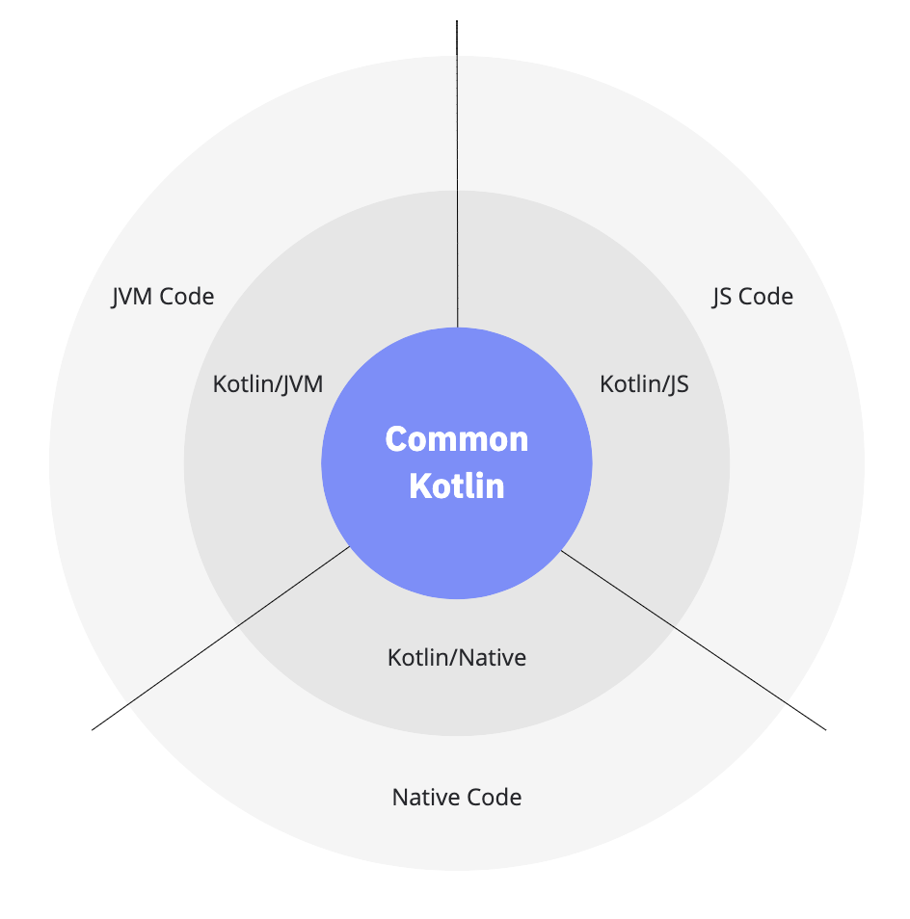
Kotlin Multiplatform: Apps for more than one platform
Plugin, Gradle integration
Project structure
Kotlin/Native: Apps for devices without a virtual machine
Target architecture
Integration
https://kotlinlang.org/docs/multiplatform.html#how-kotlin-multiplatform-works

Slide 10
Kotlin/Native
Compiles Kotlin into native code
LLVM-based backend for the Kotlin compiler
Provides
native implementations of the Kotlin standard libraries
interop to the platform
bindings for platform-specific libraries

Slide 11
Based on platform and target, Kotlin/Native creates
executables
static or dynamic libraries with headers for C and C++ projects
Apple frameworks for Objective-C and Swift projects
Kotlin code can consume
existing static or dynamic C libraries
Swift and Objective-C frameworks

Slide 12
Not important for Compose for Desktop (based on the JVM)
Will be when Compose for iOS arrives

Slide 13
Tooling-related terms
Projects are structured using source sets
Typically two branches
main for the code
test for unit tests

Slide 14
Targets
Build, test, and package artefacts for a platform
Are fuelled by one or more source sets
Consist of one or more compilations

Slide 15
Compilations
Structure code regarding usage (test, production)
Standard compilations: main and test
Each compilation has a default source set
If needed custom compilations can be configured

Slide 16
Target multiple platforms
Re-use code across platforms
Implement platform-specific features as platform-specific code
Common (shared) code is in kotlinMain
Platform specific code is in xyzMain
Kotlin supports implementing for more than one platform with expect and actual

Slide 17

Demo
https://unsplash.com/photos/ZIjdTtJ4YOs

Slide 18

Questions…?
Short break… 😍

